Slide 1



Welcome to GAI
Discord
RSVP for Workshop 2
Instagram
First Workshop
https://z.umn.edu/gai-second-workshop

Slide 2
Workshop Overview
Neural Networks
Basics of LangChain

Slide 3
Clarification on OpenAI API Key Usage
Costs are personally paid for by GAI officers
Free to use during meetings/workshops or personal learning
Please do not use for large-scale projects
If we believe you are making an unreasonably large amount of requests, we will unfortunately have to remove your key

Slide 4
What is LangChain?

Slide 5
Okay, so LangChain
Framework for developing applications which use LLMs
Simplifies the interactions between LLMs, APIs, databases, and other external tools
Provides useful modular components like Chains, Memory, Document Loaders, and Agents
Doing the first two today!

Slide 6
LangChain Advantages
Simplify software development by reducing the complexity of integrating LLMs
Easy to chain components together and treat it as one tool
Can maintain memory across multiple different interactions
Supports wide variety of integrations (OpenAI, HuggingFace, vector dbs, etc)
Utilize agents and tools, which enables the LLMs to make decisions and call functions dynamically

Slide 7
LangChain Uses
Conversational AI – Chatbots with memory and context
Search & Retrieval – AI-powered search over documents
Agents – LLMs that interact with APIs and tools
Summarization – Automated content summarization
Custom Workflows – Chain together multiple AI functions

Slide 8
Neural Networks: Basics
https://youtu.be/bfmFfD2RIcg?si=isojSAXZOMT9wrtc
^First ~4 minutes

Slide 9
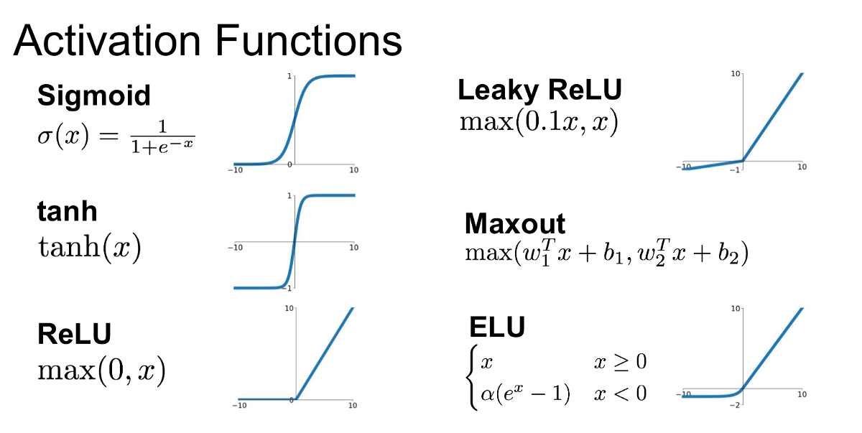
What NNs do
Can basically model any equation (whether linear or nonlinear)
Activation function & layers allow us to model non-linearity in our data
Improve accuracy by making overfitting more difficult - manipulate data, add dropout to increase network resiliency, etc.
Many ways to structure network, data to create different outputs (classifications, sequence generation)

Slide 10
Some Common Networks & Their Uses
A regular NN could output classifications, regression values, probability distributions.
Convolutional Neural Network (CNN) - Image Classification
Recurrent Neural Network (RNN) - time series data (think stock predictions)
Generative Adversarial Network (GAN) - image generation.
Some networks (especially LLMs) have ‘transformers’, which use implement something called self-attention to help deal with data that includes long range dependencies, such as sequential data.

Slide 11
PyTorch Training Code - Brief Walkthrough
outputs = model(data)
loss = criterion(outputs, data)
loss.backward()
optimizer.step()
running_loss += loss.item()
Get model output
Calculate how off model was from the ground truth according to some criteria (i.e., MAE)
Compute the gradients of the loss wrt. the model’s parameters using backpropagation.
Updates the model's parameters using the computed gradients via an optimizer
Grabs ‘how much model missed by’ so us humans can track the progress

Slide 12
Food and socialize
Come talk to me if you don’t have an API key set up yet

Slide 13
Let’s Get Started!
https://z.umn.edu/gai-first-workshop-code

Slide 14
THANK YOU!

Slide 15
RSVP for Workshop 2
https://z.umn.edu/gai-second-workshop

